Slide 1
Welcome to Language Arts
Introduction to L.A.
Mrs. Ware

Slide 2
P R O C E D U R E S
Line up outside the classroom wall and a teacher will permit you into the room.
Promptly go to your assigned seat.
ALL materials must be out and ready when the bell rings.
The very first thing you do in ALL classes is fill in your planner. EVERY. DAY.

Slide 3
Student Behaviors
Be prompt
Be ready to learn when class begins.
I EXPECT YOU TO BE IN YOUR ASSIGNED SEAT UPON ARRIVAL
Be prepared
Have materials with you and know due dates.
ALL PENCILS MUST BE SHARPENED AND READY TO GO BEFORE CLASS BEGINS.
Be a polite and positive participant
Speak in a normal tone of voice, and listen attentively.
Be productive
Turn in work on time, and always do your best.
NO LATE WORK IS ACCEPTED
Be a problem solver
Correct problems quickly and peacefully before they escalate.

Slide 4
Show Respect. Be kind.
Value yourself. Be honest and ethical, and practice strong moral values.
Treat all members of the school community and all visitors with politeness and respect.
Honor the ideas and opinions of others.
Offer to help.
Be responsible with property and belongings.
Simply do the RIGHT thing.

Slide 5
C L A S S W O R K
THINGS YOU WILL NEED EVERY DAY:
PLANNER
LANGUAGE ARTS FOLDER
PENCIL
PAPER

Slide 6
Policies
Food/drinks/gum are not permitted in the classroom.
Please be in your seat when the bell rings, as class begins at that time.
If you are absent, you are responsible for getting your work from the “Absent Folder”.
Late work will not be accepted.
Neither will rudeness/disrespect.

Slide 7
My Pledge to Students
I will trust you until you give me reason to do otherwise.
I will respect you and work with you to solve problems.
I will promptly correct and offer feedback on your work.
I will work with you to meet learning goals.
I will offer extra help and alternative assessments should you require them.

Slide 8
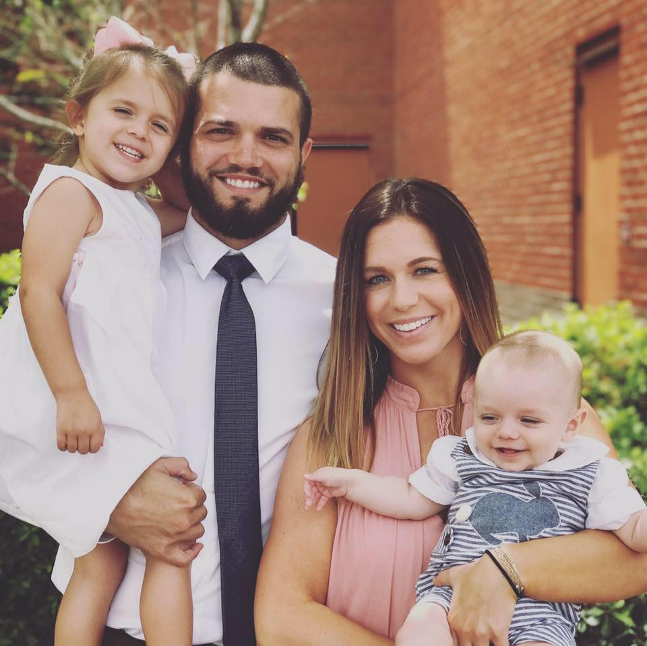
M R s. W a r e

Slide 9
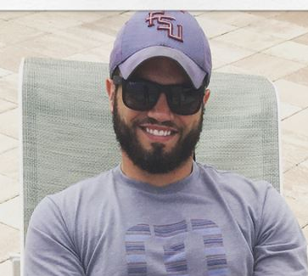
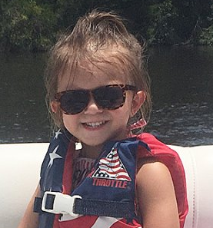
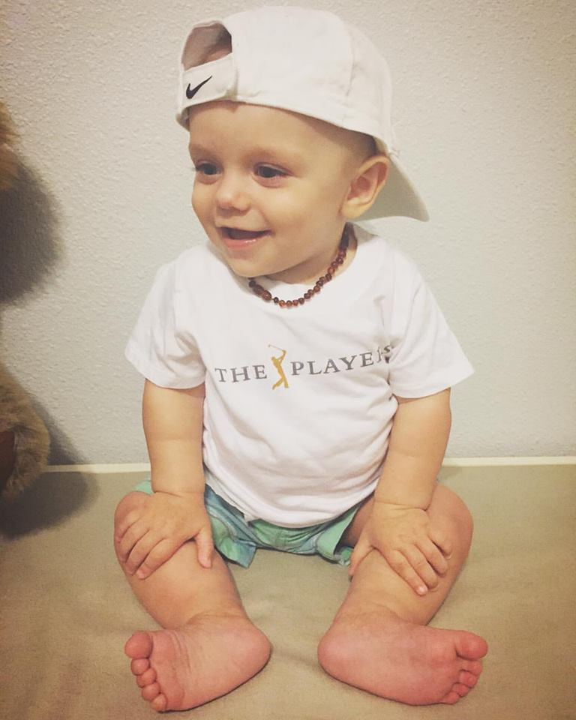
My family
SCOUT
Laney

Slide 10
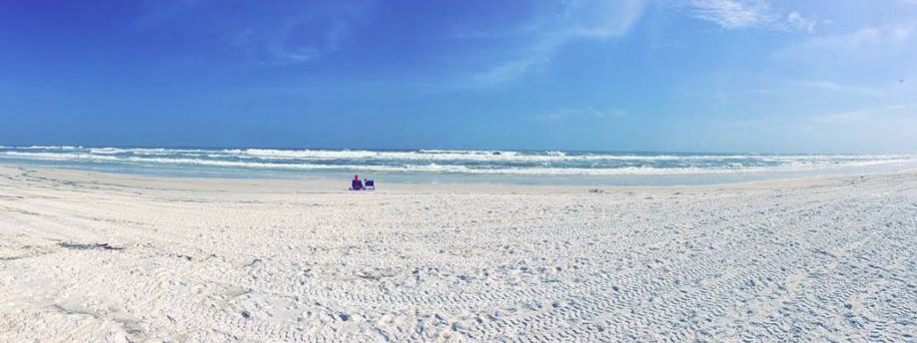
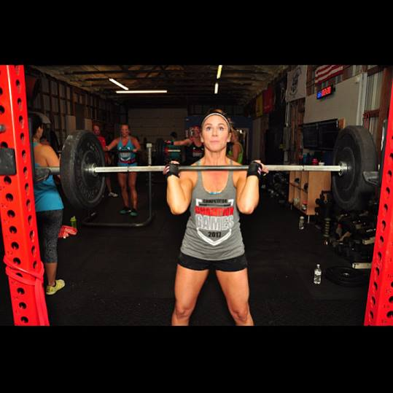
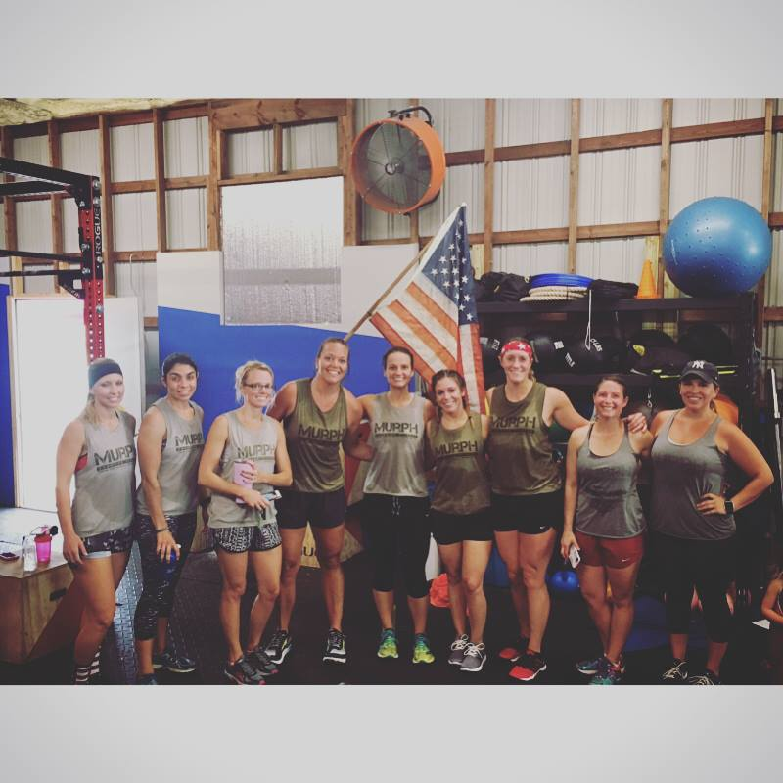
hobbies
BEACH
CROSSFIT

Slide 11
MY TEAMS

Slide 12
MY FAVORITES

Slide 13
Ready for a great year!

