Slide 1
11/27/17
NEW Seats! Take a seat anywhere and I will put you in an assigned seat when the bell rings.

Slide 2
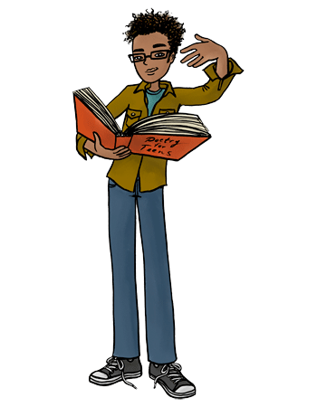
Poetry Unit
Sound Devices
Figurative Language

Slide 3
Alliteration
Definition | Example
Repetition of consonant sounds in the beginning of words | Lovely lonely light Wintery white wonderland

Slide 4
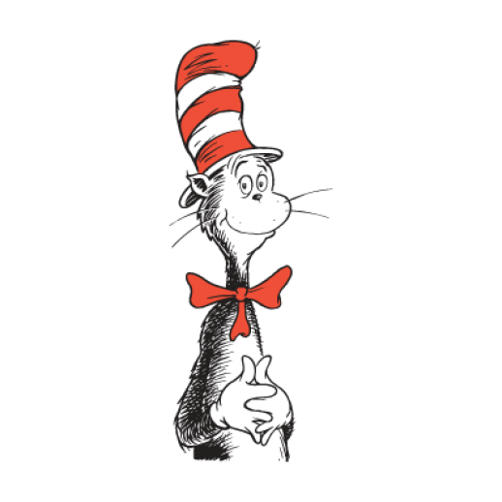
Rhyme
Definition | Example
Repetition of sounds at the END of lines | Pool, rule, fool Fun, sun, pun

Slide 5
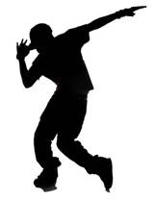
Rhythm
Definition | Example
The beat created by the pattern of stressed and unstressed syllables | The cat sat on the mat

Slide 6
Meter
Definition | Example
Regular rhythm/ rhythmical pattern | My father was the first to hear He sang loud with lots of cheer

Slide 7
Onomatopoeia
Definition | Example
The use of words that imitate sound | Crash Bang Hiss Splat Boom
SPLAT!

Slide 8
Free Verse
Definition | Example
Poetry not written in a regular, rhythmical pattern, but instead written in ANY length of lines and/or stresses | I am a lion Hear me roar I can conquer the land

Slide 9
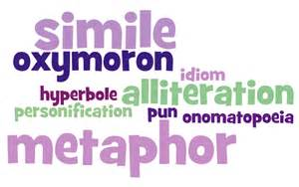
FIGURATIVE LANGUAGE

Slide 10
Allusion
Definition | Example
Reference or mention to a well-known person, event, place, or work of art | Elvis has left the building; The eagle has landed

Slide 11
Analogy
Definition | Example
A comparison between two or more things that are similar in some ways, but otherwise unalike. | Tree is to forest as building is to city Doctor is to medicine as President is to government

Slide 12
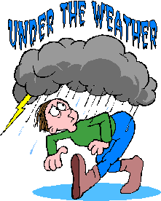
Hyperbole
Definition | Example
EXAGGERATION | She cooked enough food to feed an army Mile high ice-cream cone

Slide 13
Metaphor
Definition | Example
Describes one thing as if it were something else Points out a similarity between two unlike things | The snow was a white blanket over the town

Slide 14
Poetry
Definition | Example
One of three MAJOR types of literature which makes use of highly concise, musical, and emotionally charged language | Lyric poetry Narrative poetry Concrete poetry

Slide 15
Personification
Definition | Example
Gives human qualities to something nonhuman | The ocean crashed angrily during the storm.

Slide 16
Personification
Definition | Example
Gives human qualities to something NON-human | The ocean crashed angrily during the storm.

Slide 17
Simile
Definition | Example
Use the words “like” or “as” to compare two unlike things and show similarities between the two | She is as slow as a turtle The room is as cold as ice

Slide 18
Mood
Definition | Example
Feeling created in the reader by a literary work or passage | Silly/nonsense Dark/dreary

