Slide 1
There, They’re, Their
These three homophones sound the same but have different spellings and meanings!

Slide 2
There
This word indicates a place.
EXAMPLE: Look over there!
EXAMPLE: Ms. Blankeship, the PE teacher, told us to run from here to there.
EXAMPLE: Please write your name on the line right there.

Slide 3
There
This word also indicates the existence of something.
EXAMPLE:There is time left in the game.
EXAMPLE: There are six puppies.
EXAMPLE: There is a girl named Jasmine in my class.

Slide 4
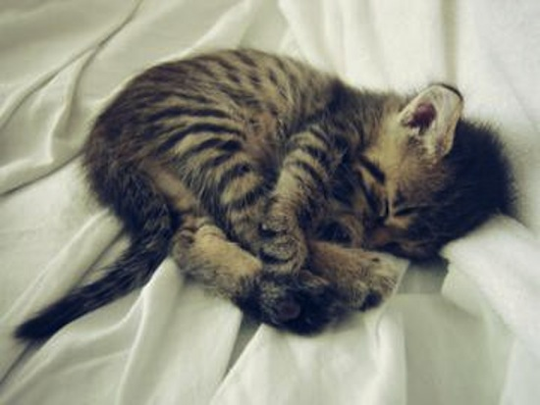
There
The kitten loves to sleep there.
There is nothing cuter than a baby animal.
Image: cutearoo.com

Slide 5
They’re
This word is a contraction that means “they are”.
EXAMPLE: They’re best friends.
EXAMPLE: They’re going to the beach.
EXAMPLE: They’re going to get an A.

Slide 6
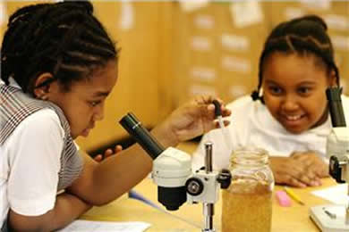
They’re
They’re going to be scientists when they grow up.
Image: leadingladiesoflegacy.org

Slide 7
Their
This word indicates ownership.
EXAMPLE: Their teacher is Mr. Siraj.
EXAMPLE: Their dog is a Chihuahua.
EXAMPLE: Their favorite sport is soccer.

Slide 8
Their
Their country is the United States.
Image: commons.wikimedia.org

Slide 9
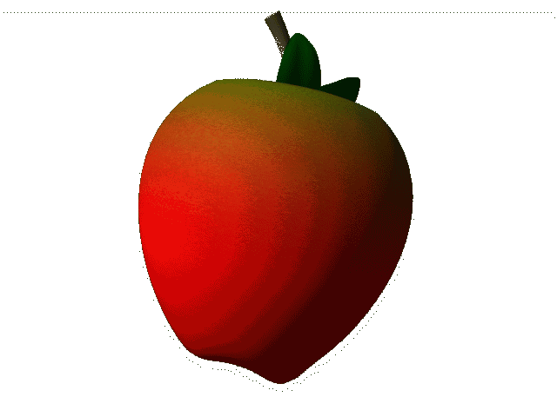
Let’s play!

Slide 10
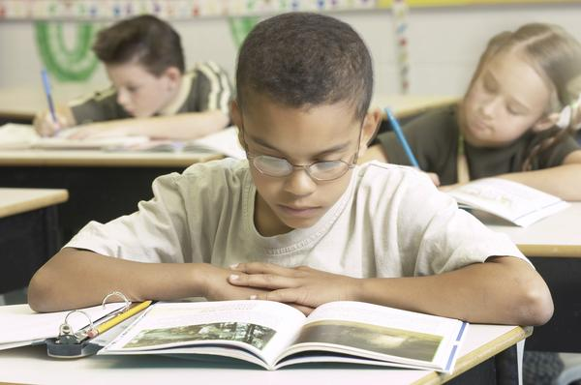
____________ fourth grade
students.
Image: everydaylife.globalpost.com

Slide 11
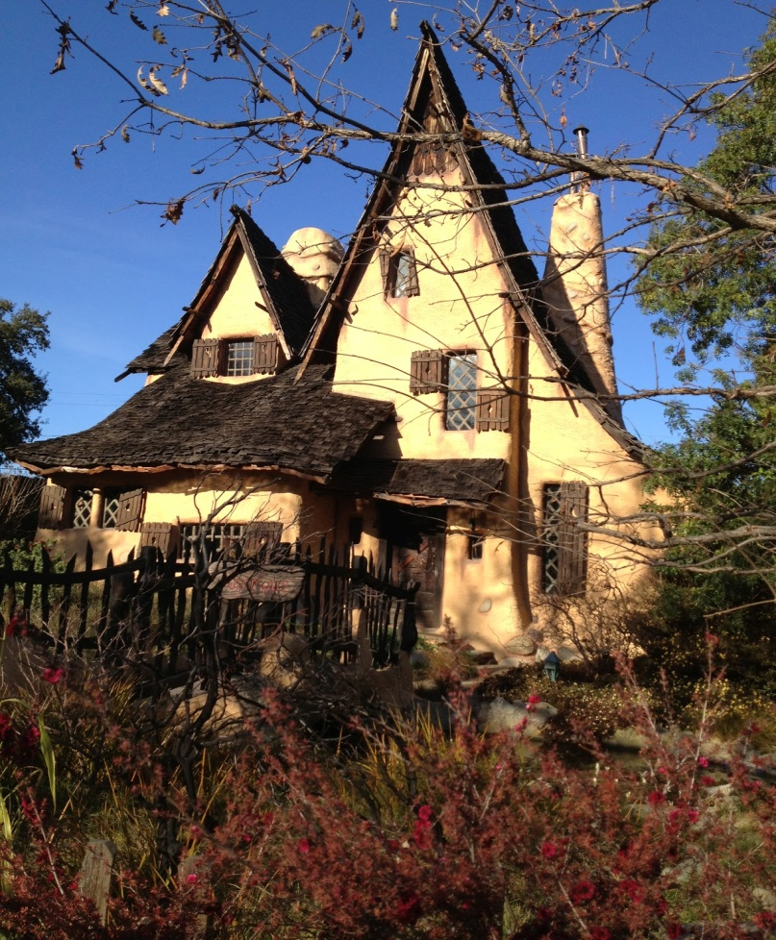
The wicked witch lives ____________.
Image: beverlygray.blogspot.com

Slide 12
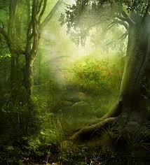
_____________ are many trees in this enchanted forest.
Image: hdemg.com

Slide 13
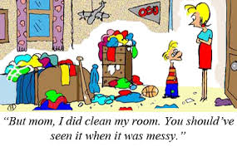
__________ mother told them to do __________ chores.
Image: www.parentfurther.com

Slide 14
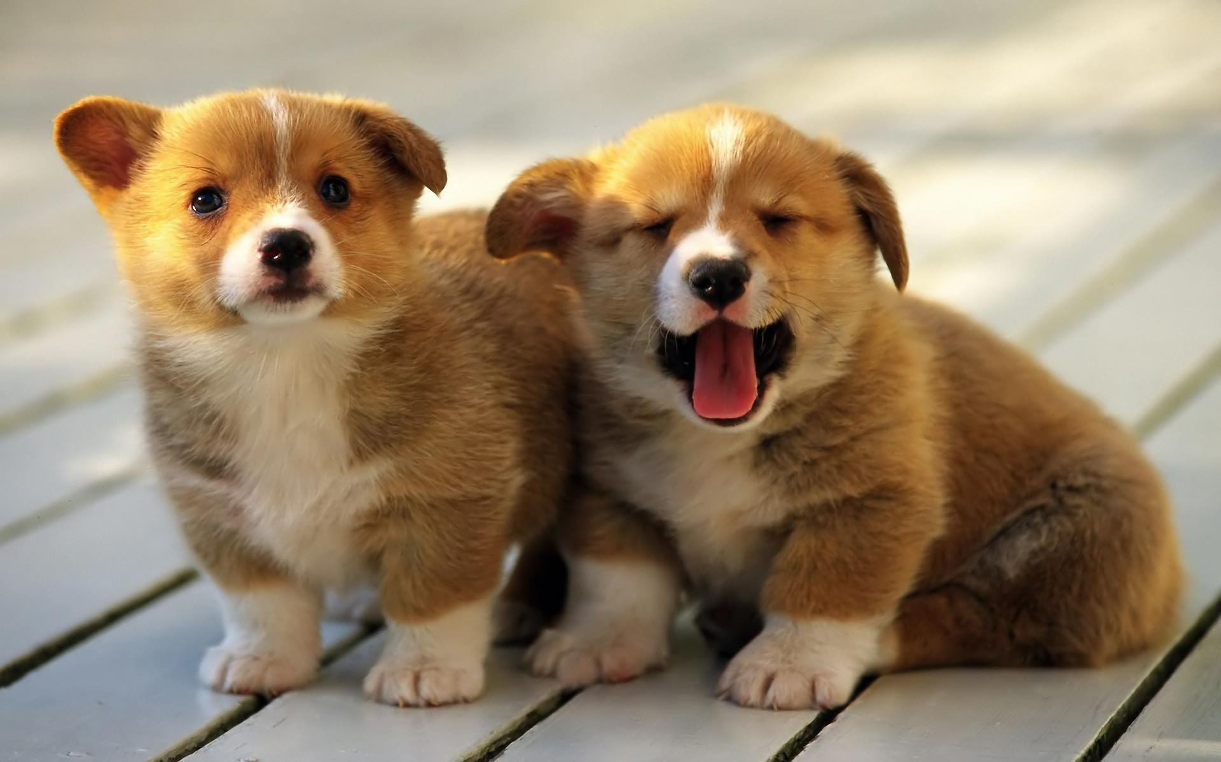
__________ just a few weeks old.
Image: polkcountyanimalhospital.com

Slide 15
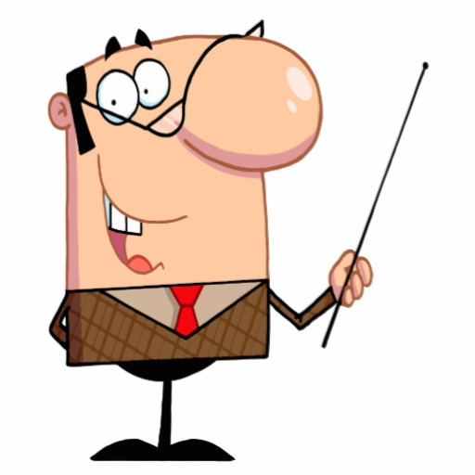
__________ teacher is very smart.
Image: www.clipartpanda.com

